Slide 1
AI IN EDUCATION
Workshop for exploring the use of AI in Education at Jönköping University and beyond
Educate, 2023-09-28

Slide 2
Contents
Introduction – What is AI?
Considerations for teachers
Ethical guidelines
Examples of AI in education
Examination

Slide 3
Introduction
What is AI?
Why the current hype?
What is generative AI?
Impact on education?

Slide 4
What is AI?
Artificial Intelligence: Several methods of building models that can solve tasks
  Speech recognition
  Spam filter
  Translation
  Games
  Robotic vehicles
  …
1950 –

Slide 5
What is generative AI?
AI built to create content
  Text
  Image
  Video
  Audio
A model of the content is created based on large sets of training data
The model is used to generate new content
Notes:
https://www.midjourney.com/showcase/top/

Slide 6
GPT and LLM
GPT: Generative Pre-trained Transformer
LLM: Large Language Model
Creates text according to statistical probability
  What is the next most likely word, given the previous content and initial prompt?

Slide 7



Examples of Generative AI chatbots
ChatGPT (OpenAI)
Bard (Google)
Bing Chat (Microsoft)

Slide 8

AI Sweden: GPT-SW3
A large-scale generative language model for the Swedish language
“AI Sweden, together with RISE and WASP WARA Media & Language, are developing a large-scale generative language model for the Nordic languages, and primarily Swedish.”
https://www.ai.se/en/node/81535/gpt-sw3
Prototype available at chat.ai.se
Notes:
GPT-SW3
GPT4All

Slide 9
AI Sweden: GPT-SW3
The model has not been finetuned specifically for helpfulness or safety, and no human feedback has been used to finetune the model. As such, this chat prototype may produce factually incorrect, misleading, and controversial content. It is not comparable to products such as ChatGPT or Bard.
This research prototype is part of the validation of GPT-SW3. Its purpose is to test functionality and to collect data for further model improvement. We provide no guarantees and no support regarding content, response time or uptime. This is a research prototype and as such may be modified or shut down at any time.

Slide 10
Considerations for teachers

Slide 11
Potential issues/Risks
Privacy
Copyright
Biased training data → Biased output
Hallucinations
Misinformation
Notes:
EDPB resolves dispute on transfers by Meta and creates task force on Chat GPT https://edpb.europa.eu/news/news/2023/edpb-resolves-dispute-transfers-meta-and-creates-task-force-chat-gpt_en
Extracting Training Data from Diffusion Models https://arxiv.org/abs/2301.13188
Copyright and Artificial Creation: Does EU Copyright Law Protect AI-Assisted Output? https://link.springer.com/article/10.1007/s40319-021-01115-0
Quantifying ChatGPT’s gender bias https://aisnakeoil.substack.com/p/quantifying-chatgpts-gender-bias
Evaluating Verifiability in Generative Search Engines https://arxiv.org/abs/2304.09848
Despite OpenAI’s Promises, the Company’s New AI Tool Produces Misinformation More Frequently, and More Persuasively, than its Predecessor https://www.newsguardtech.com/misinformation-monitor/march-2023/
Co-Writing with Opinionated Language Models Affects Users’ Views https://dl.acm.org/doi/10.1145/3544548.3581196
Microsoft announces new Copilot Copyright Commitment for customers https://blogs.microsoft.com/on-the-issues/2023/09/07/copilot-copyright-commitment-ai-legal-concerns

Slide 12
Impact on education? Example of the current debate!
“The potential impact of AI tools on assessment” (Bommenel & Forsyth, 2023)
Three main options for considering AI writing tools in assessment
To ban their use
To assume that they may be used, and set tasks which incorporate them
To require them to be used – fully incorporate the tools in the assessment
Notes:
https://www.education.lu.se/artikel/potential-impact-ai-tools-assessment

Slide 13
Equity and digital literacy
Educate survey: AI in Academia
The Digital Divide
Digital transformation in higher education

Slide 14
Questions
Q1 Express the likelihood of the following scenarios:
Using content-generating AI tools would decrease the effort needed for a student to complete your course assignments.
There is a reasonable concern that students can abuse content-generating AI tools to pass the exam in your course.
I would suggest students to use and experiment with content generating AI tools.
I see potential in using content-generating AI tools for preparing for my teaching tasks.
Q10 How do you perceive content generating AI tools?
Q12 How would you self asses your digital literacy?
Q18 I have a sufficient knowledge about the content generating AI, such as chatGPT.
Findings
Strong correlations between questions 1-1 and 1-2, 1-3 and 1-4, 1-3 and 10, 1-4 and 10 as well as 12 and 18.
Negative correlation between question 1-2 and 1-3
Framed correlations in the visualisation are statistically significant (p-value <0.05)

Slide 15
Hypotheses from AI in Academia Survey
Faculty who agree that using content-generating AI tools would decrease the effort needed for a student to complete your course assignments also tend to agree with the statement that there is a reasonable concern that students can abuse content-generating AI tools to pass the exam in your course.
Faculty who would suggest students to use and experiment with content generating AI tools also say that they see potential in using content-generating AI tools for preparing for my teaching tasks.

Slide 16
Hypotheses from AI in Academia Survey
Faculty who view content generating AI tools as an opportunity rather than a threat are more likely to suggest use to students and to see potential.
The self-assessment of digital literacy correlates negatively with concern for abuse, and positively with recommending AI to students.
The self-assessment of digital literacy correlates with perceived sufficient knowledge of AI.

Slide 17
Chalmers student survey
5894 students from all Swedish universities (April – May 2023)
95% of students are familiar with ChatGPT, while awareness of other chatbots is very low
56% are positive about using chatbots in their studies; 35% use ChatGPT regularly
60% are opposed to a ban on chatbots, and 77% are against a ban on other AI tools (such as Grammarly) in education
Notes:
https://www.chalmers.se/en/current/news/cls-students-positive-towards-ai-but-uncertain-about-what-counts-as-cheating/
https://research.chalmers.se/en/publication/535715

Slide 18
Chalmers student survey
More than half of the students do not know if their institution has guidelines for how AI can be used in education
  One in four explicitly says that their institution lack such regulations
62% believe that using chatbots during examinations is cheating
Students express some concern about AI development, and there is particular concern over the impact of chatbots on future education
Notes:
“Many respondents share anecdotal narratives suggesting that AI chatbots and language tools can provide substantial support for individuals with disabilities such as dyslexia, ADD, ADHD, and autism.”

Slide 19
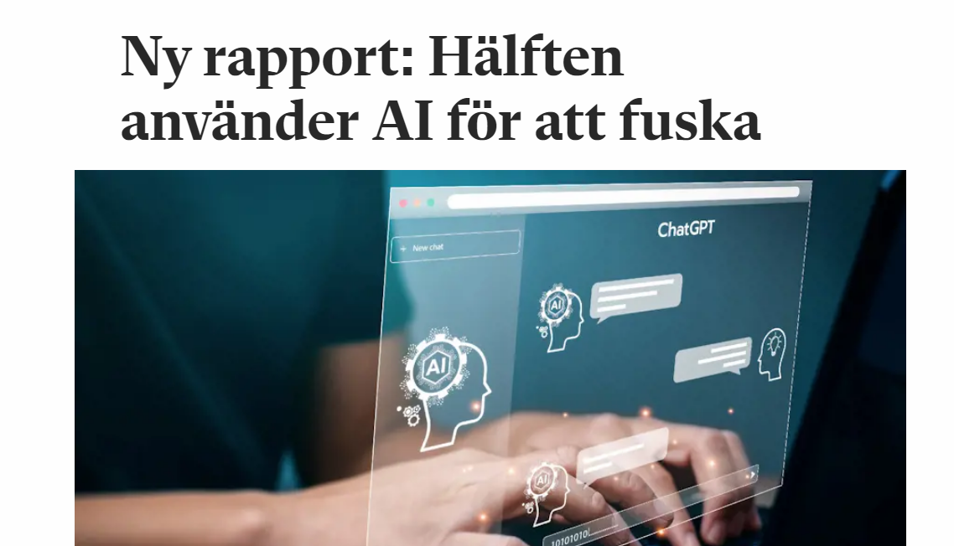
50% of students use AI to cheat?
A new report reveals that many young people aged 15 to 24 in Sweden use AI to cheat in school
54% of the 1,000+ respondents admitted to using AI in a potentially unauthorized manner for schoolwork.
40% were unsure about the existence of school rules regarding AI use.
33% confirmed the presence of such rules.
27% said there were no such rules.
Notes:
Ulrik Hoffman from Ungdomsbarometern expressed surprise at these findings. The Swedish National Agency for Education, Skolverket, suggests teachers re-evaluate their methods instead of imposing strict AI rules. A generational attitude difference regarding what constitutes cheating with AI is suggested, comparing the use of AI to enhance text to using spell-check in Word.
Hoffman emphasizes the need for schools to collaboratively develop an AI policy with students, acknowledging the challenges of keeping such policies relevant in a rapidly changing tech landscape.

Slide 20
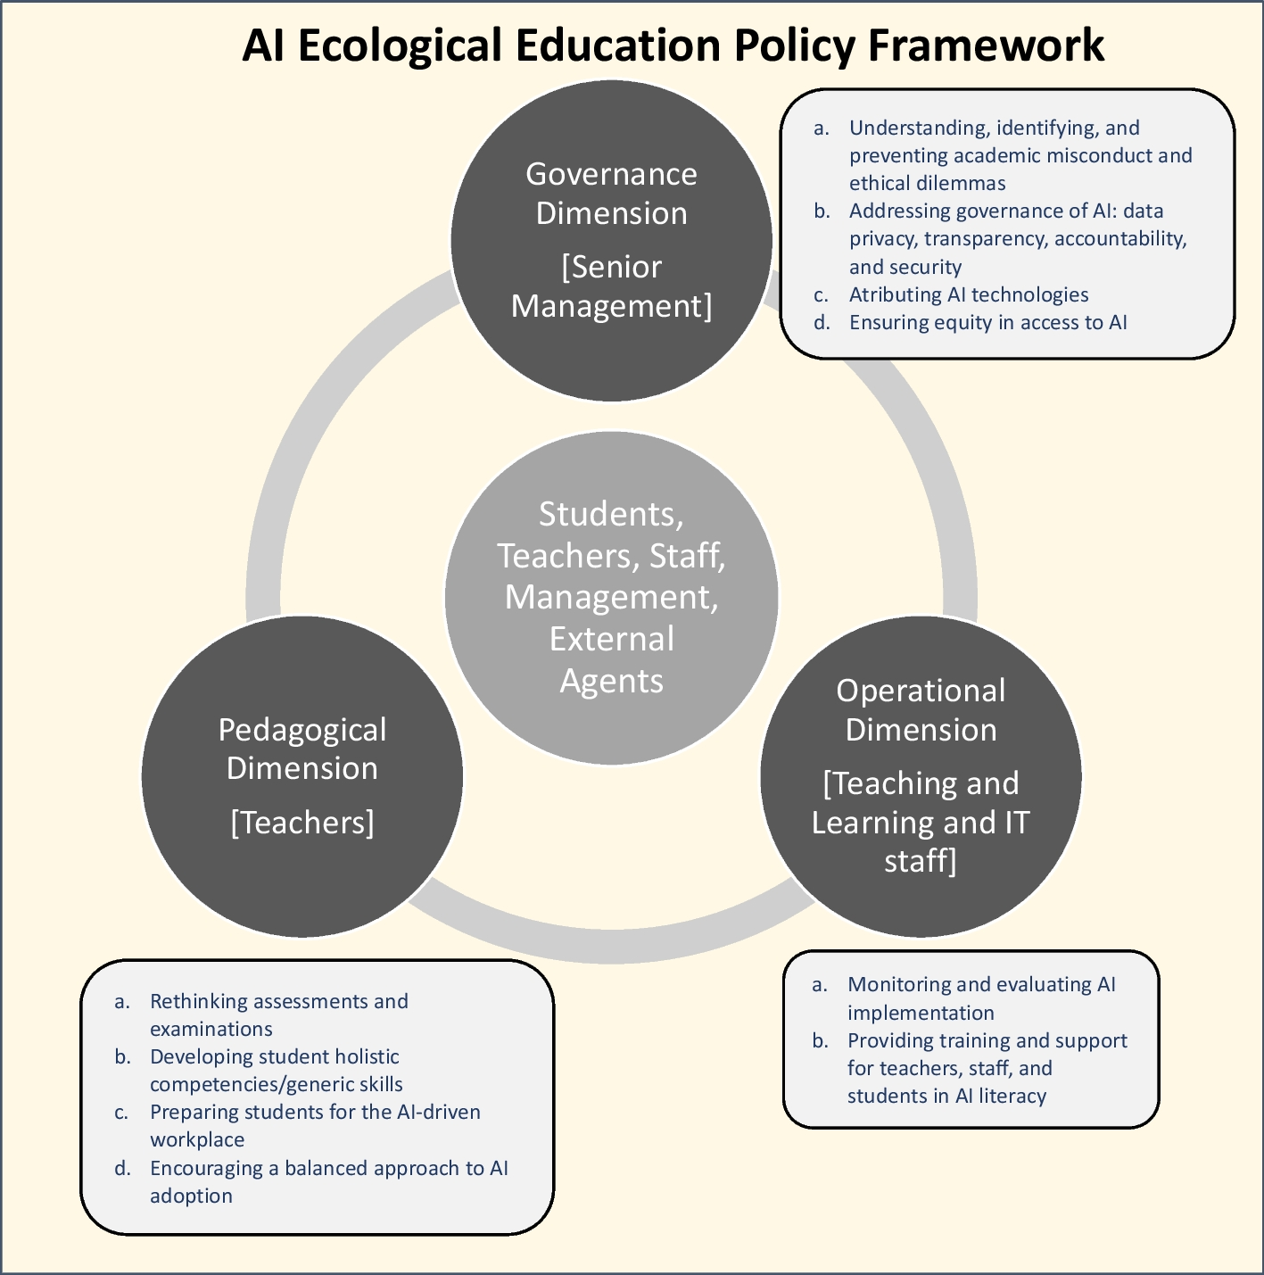
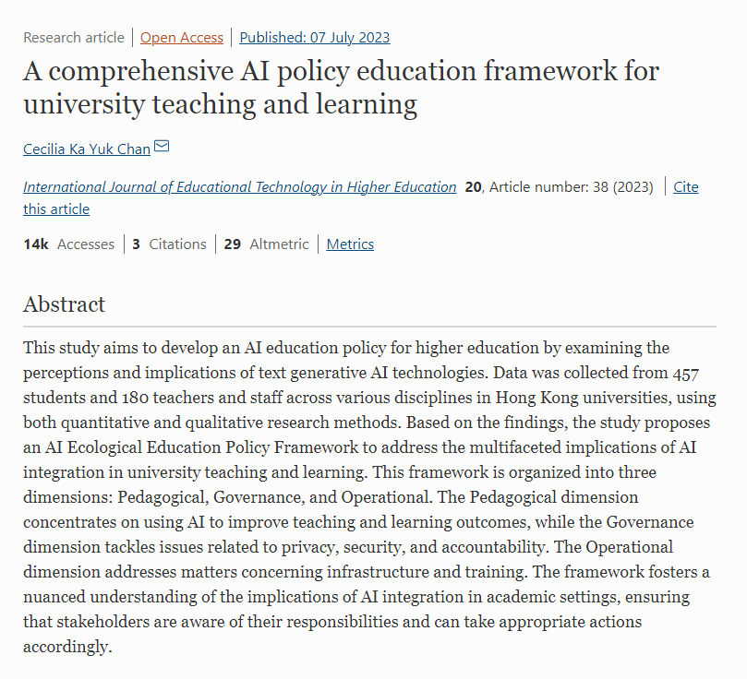
AI policy education framework
Three dimensions - Pedagogical, Governance, and Operational
Pedagogical dimension focuses on using AI to improve teaching and learning outcomes
Governance dimension tackles issues related to privacy, security, and accountability.
Operational dimension addresses matters concerning infrastructure and training.
Notes:
https://educationaltechnologyjournal.springeropen.com/articles/10.1186/s41239-023-00408-3

Slide 21
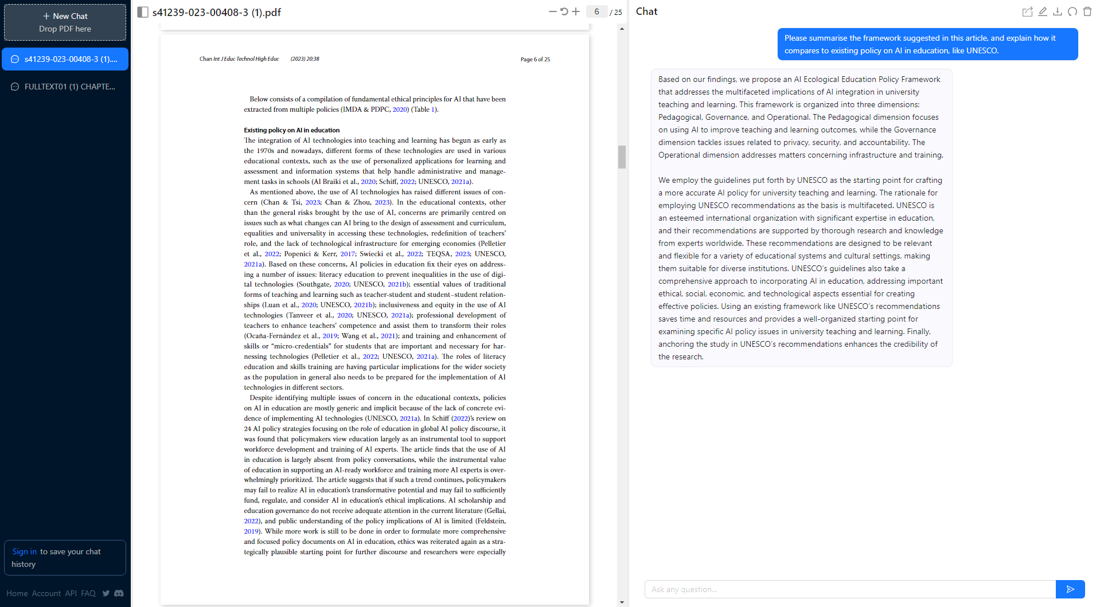

Slide 22
Ethical guidelines
European commission
  Ethical guidelines on the use of artificial intelligence and data in teaching and learning for educators
  Ethics guidelines for trustworthy AI
Ex. Från svenska lärosäten
  “Vägledning om användning av AI-drivna chattbotar vid utbildning och forskning“ (SU)
  “AI i undervisningen” (LU)
  “AI i högre utbildning” (LNU)
UNESCO
  Guidance for generative AI in education and research
Notes:
https://op.europa.eu/en/publication-detail/-/publication/d81a0d54-5348-11ed-92ed-01aa75ed71a1/language-en
https://op.europa.eu/en/publication-detail/-/publication/d3988569-0434-11ea-8c1f-01aa75ed71a1

Slide 23
Ethical use of AI in education
Transparency: Educators must ensure transparency in the use of AI, including the data sources used, algorithms applied, and any decision-making processes.
Beneficence: The use of AI in education should aim to benefit students, teachers, and society as a whole.
Accountability: Educators must be accountable for the use of AI systems in education, and there should be clear lines of responsibility for any outcomes resulting from their use.
Professional responsibility: Teachers and educators must use AI in a responsible and professional manner, taking into account the potential impact on learners.
Security: AI systems used in education must be secure and protect against unauthorized access or misuse of data.
Notes:
Summary of the European Commission guidelines made by ChatGPT.

Slide 24
Ethical use of AI in education
Respect for fundamental rights: AI systems must respect fundamental rights, including privacy, non-discrimination, and freedom of expression.
Fairness: AI systems must be designed to avoid and mitigate any bias or discrimination.
Inclusiveness: AI should be designed in a way that ensures that all learners can benefit equally, regardless of their background or abilities.
Accessibility: AI should be designed in a way that makes it accessible to all learners, including those with disabilities or other special needs.
Human oversight: AI should be used to support, not replace, human educators, and there should always be human oversight of any AI systems used in education.
Notes:
Summary of the European Commission guidelines made by ChatGPT (cont).

Slide 25
UNESCO GUIDELINES for the use of generative ai in education and research
Develop policies that are human-centred and promote human agency, inclusion, equity, gender equality, cultural and linguistic diversity, as well as plural opinions and expressions.
Identify and address ethical and policy issues around AI and generative AI, including issues related to privacy, bias, transparency, and accountability.
Use simple, clear, and straightforward language when designing generative AI systems, and include context and examples to ensure that generated completions are relevant and meaningful.
Notes:
https://unesdoc.unesco.org/ark:/48223/pf0000386693/PDF/386693eng.pdf.multi

Slide 26
UNESCO GUIDELINES for the use of generative ai in education and research
Develop comprehensive policy frameworks that regulate the use of generative AI in education and research, with a focus on promoting quality education, social equity, and inclusion.
Ensure that policies are regularly reviewed and updated to keep pace with technological developments and changing societal needs.
Foster collaboration and dialogue among stakeholders, including educators, researchers, policymakers, and civil society, to ensure that generative AI is used in ways that benefit society as a whole.
Notes:
https://unesdoc.unesco.org/ark:/48223/pf0000386693/PDF/386693eng.pdf.multi

Slide 27
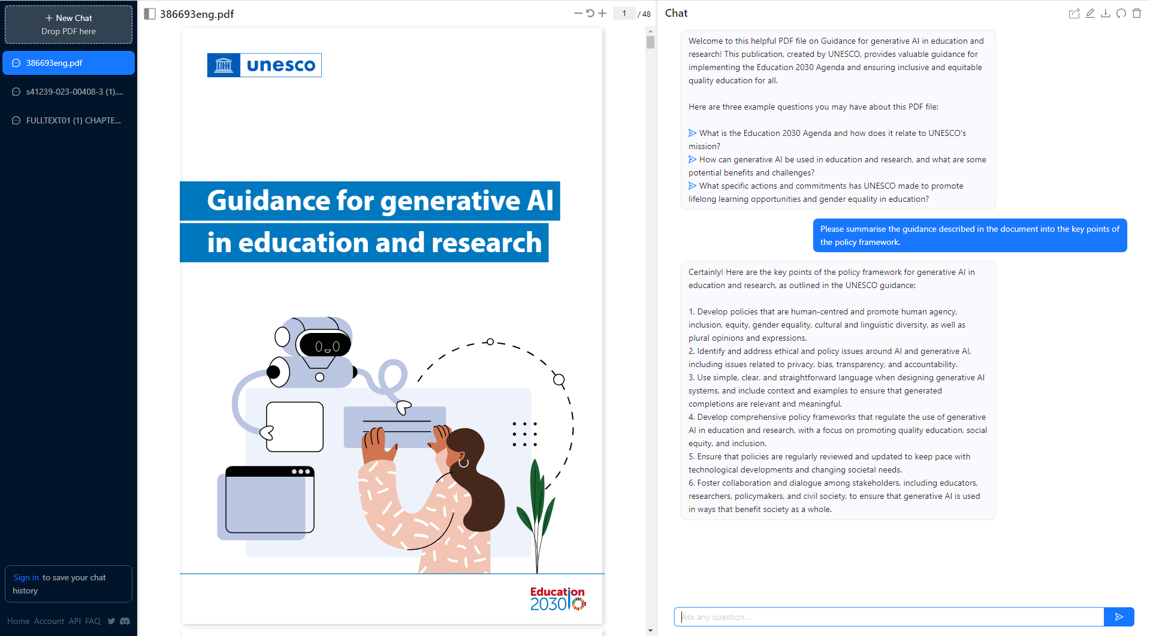

Slide 28
Examples of AI in education

Slide 29

Private use only
JU does not supply any generative AI tools
No tech support from JU
Tools are used as a private person,
not as a member of staff
Registration with private account needed
Ethical considerations
Data protection restrictions

Slide 30
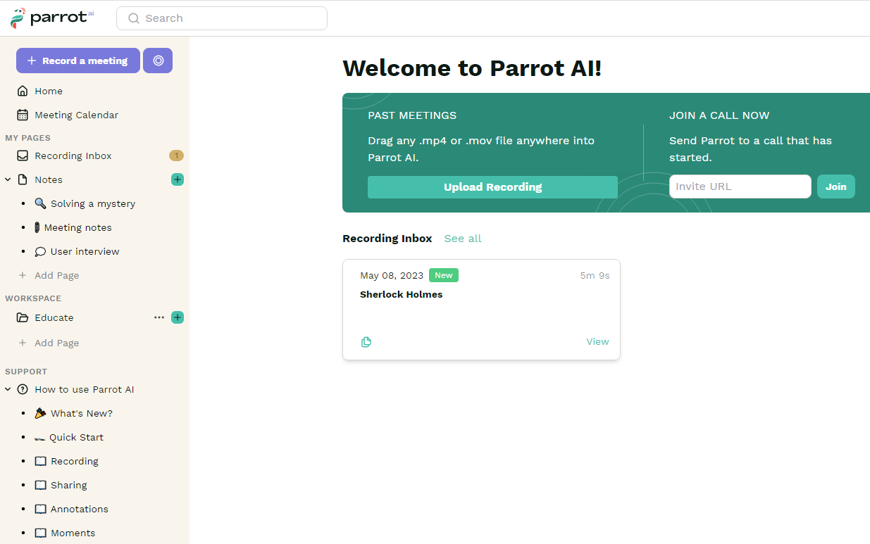
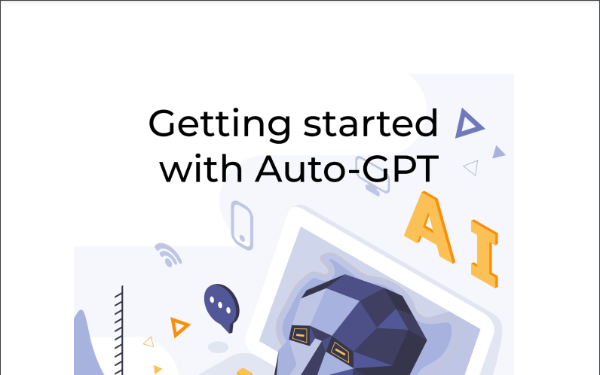
Parrot AI
Free tool, GDPR compliant but servers outside EU.
Can join Zoom and Teams meetings, transcribe meetings, record screen and take action
Try it out:
app.parrot.ai

Slide 31
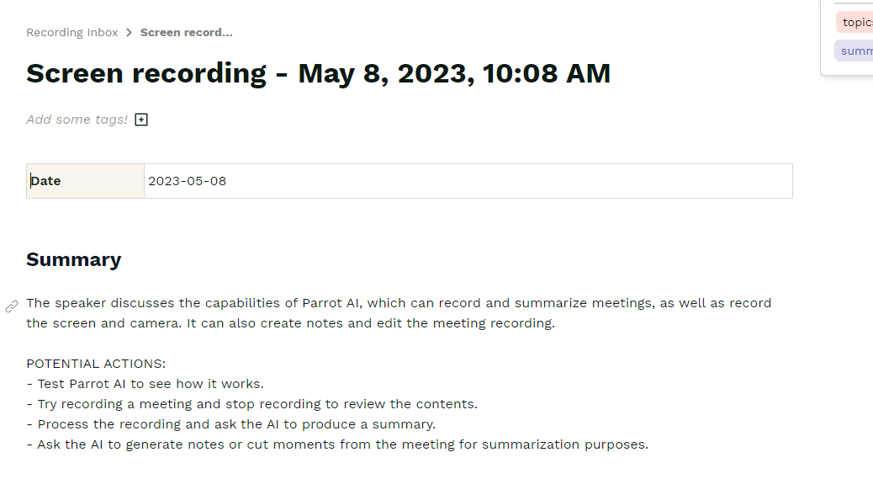

Slide 32
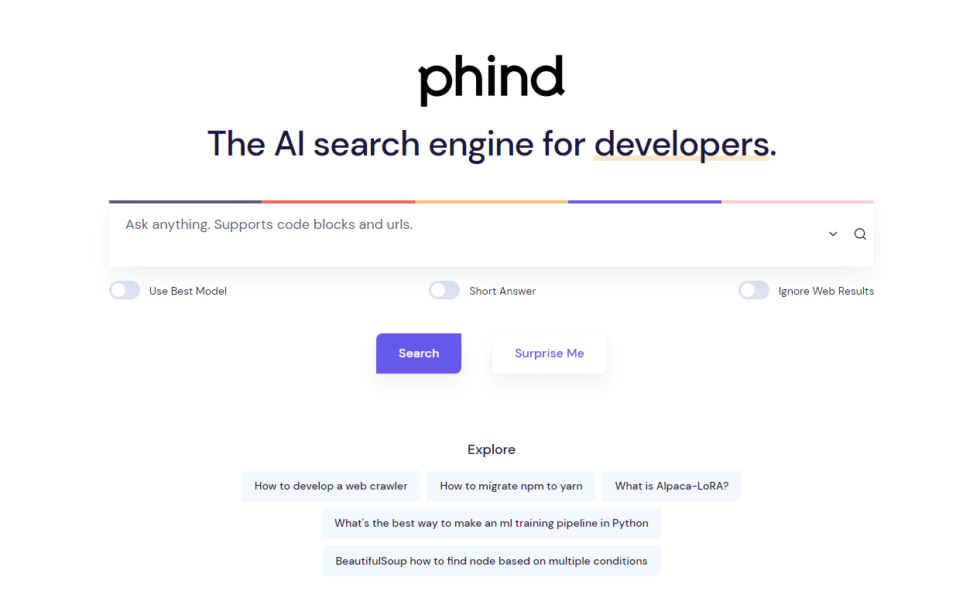
Phind
AI based search tool for developers
No login needed
Answers all coding questions with recommendations and sample code
Try it out:
phind.com

Slide 33
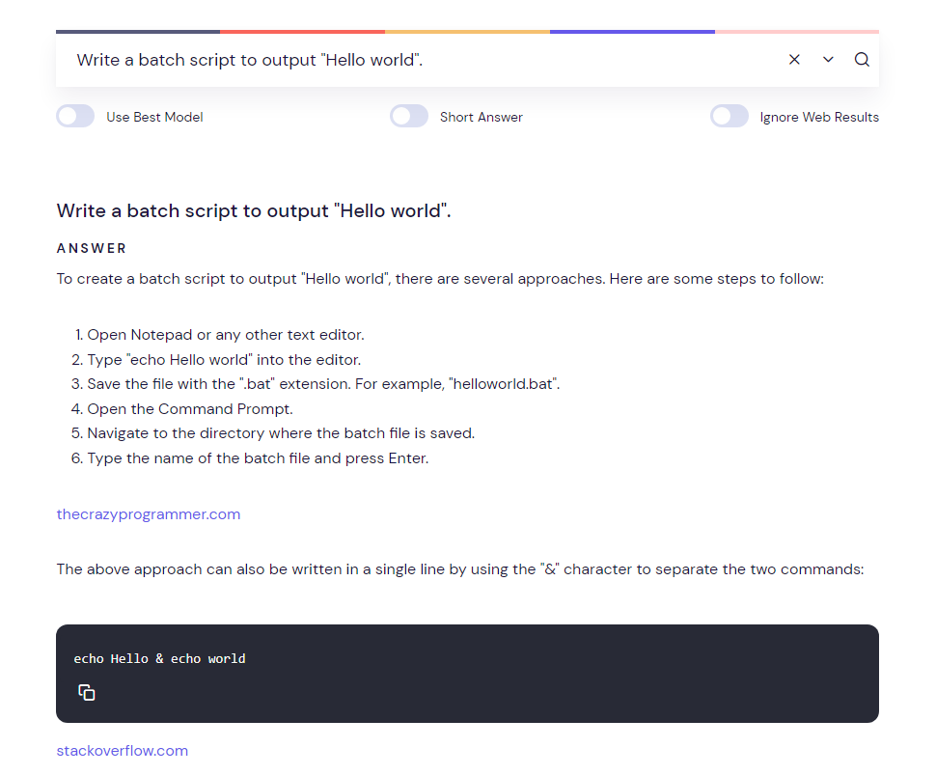

Slide 34
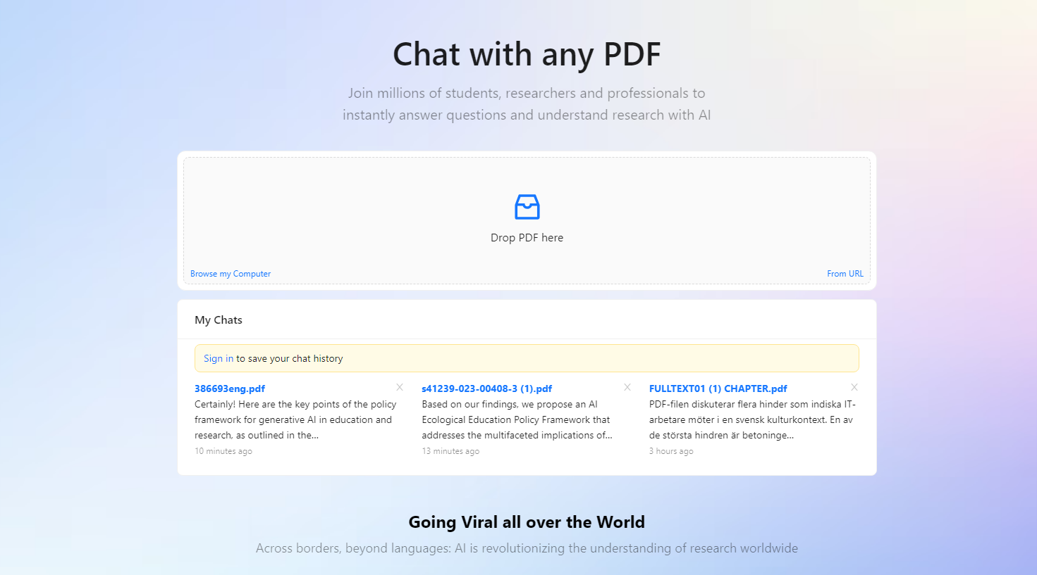
CHATPDF
Train ChatGPT on your own specific text
No login needed, only to save chats
PDF is never shared, but cloud storage is used
Try it out:
chatpdf.com

Slide 35
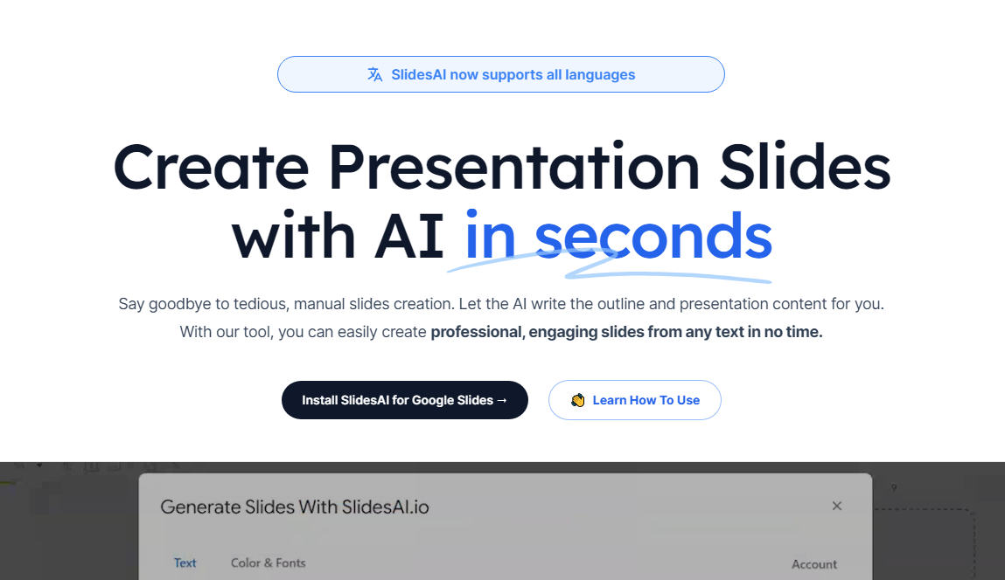
Slides AI
Create slides from text automagically
Works with Google
Data collection, paid for more than 3 slides per month
Try it out:
slidesai.io

Slide 36
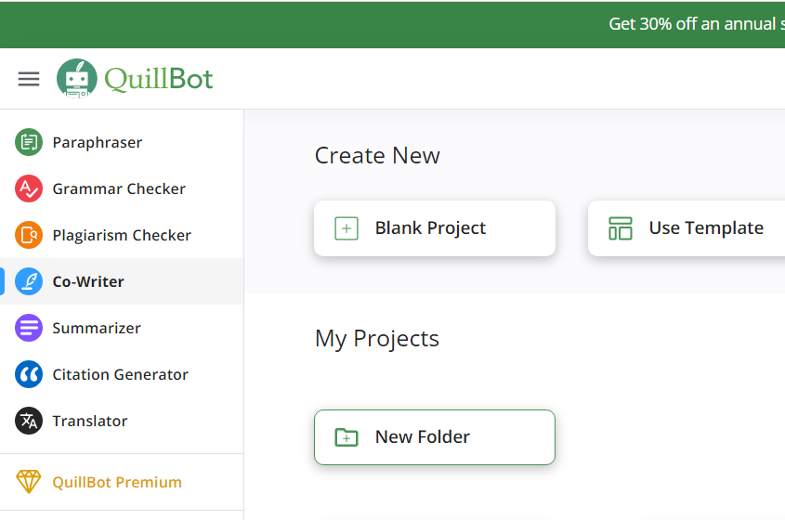
Quillbot
Paraphrase, check grammar, plagiarism, summarise, co-write, generate citations, suggest references
No login needed, paid version
Data collection
Try it out:
quillbot.com

Slide 37
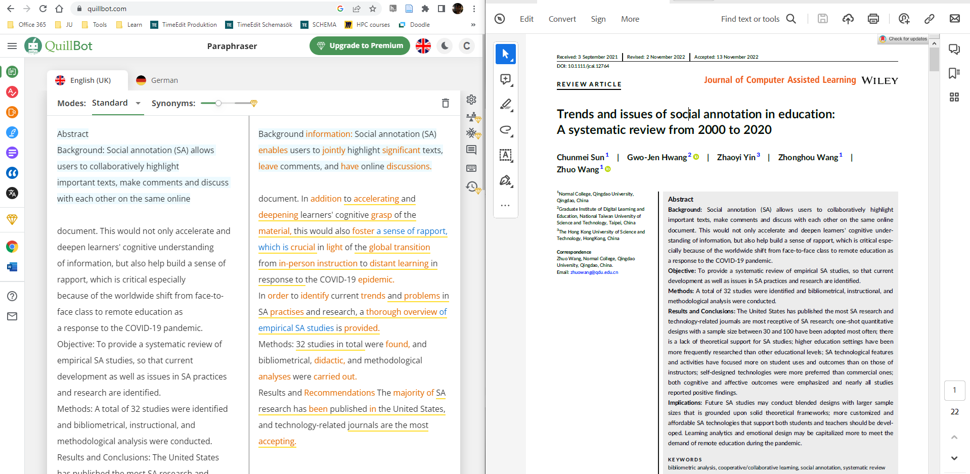

Slide 38
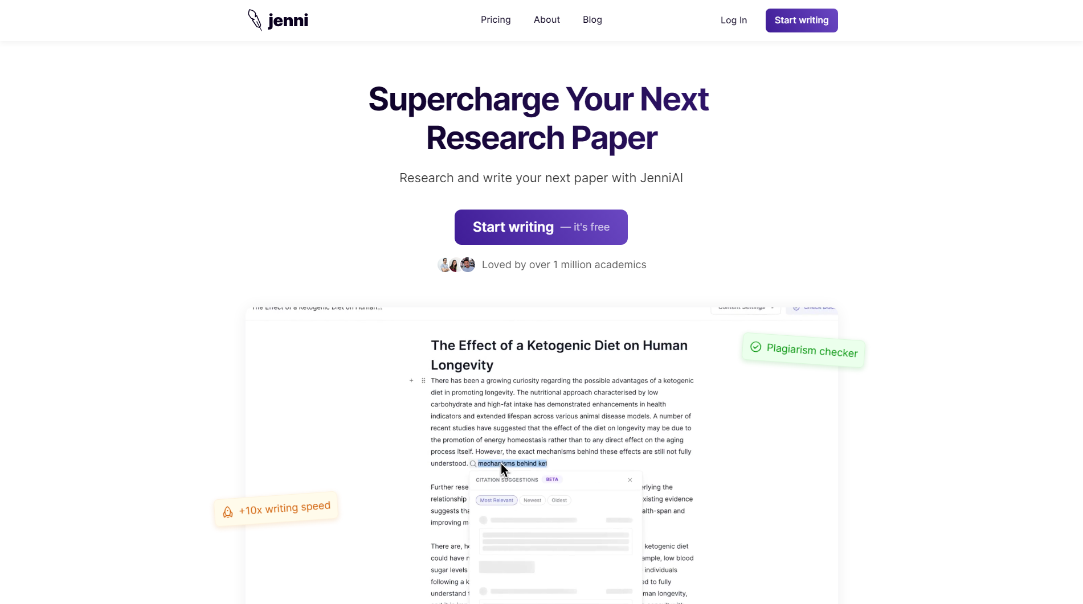
JENNI
Academic Paper Writing
Writing assistant
Login needed
Not GDPR compliant
Try it out:
app.jenni.ai

Slide 39
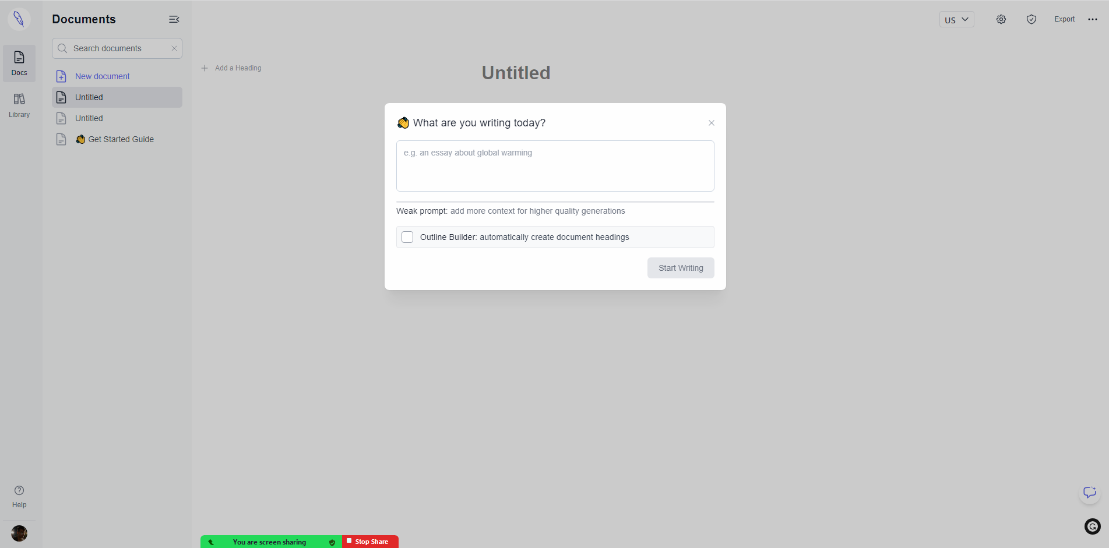

Slide 40
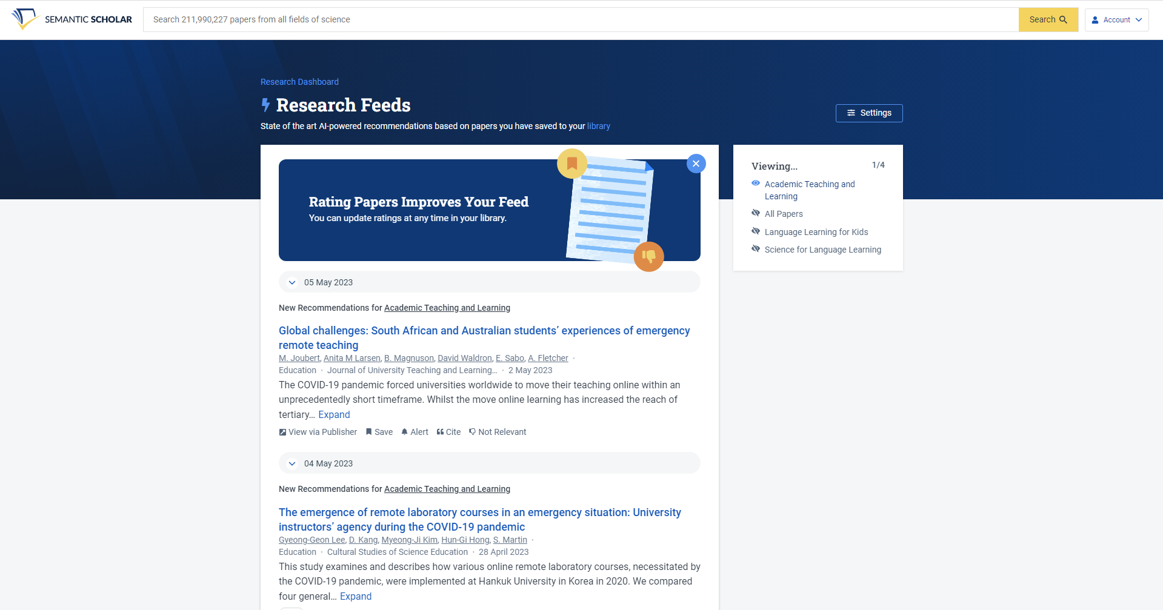
Semantic Scholar
AI based search algorithms for finding relevant academic articles
No login needed, free account for creating “research feeds”
Try it out:
semanticscholar.org

Slide 41
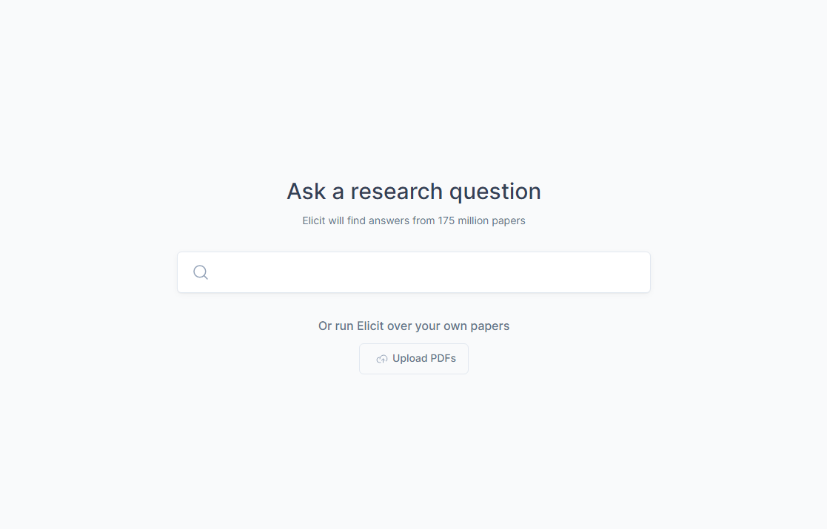
Elicit
AI research assistant
Create abstract summaries per article, summarise all papers, specify outcomes, search similarities and differences, etc.
Login needed
Try it out:
elicit.org

Slide 42
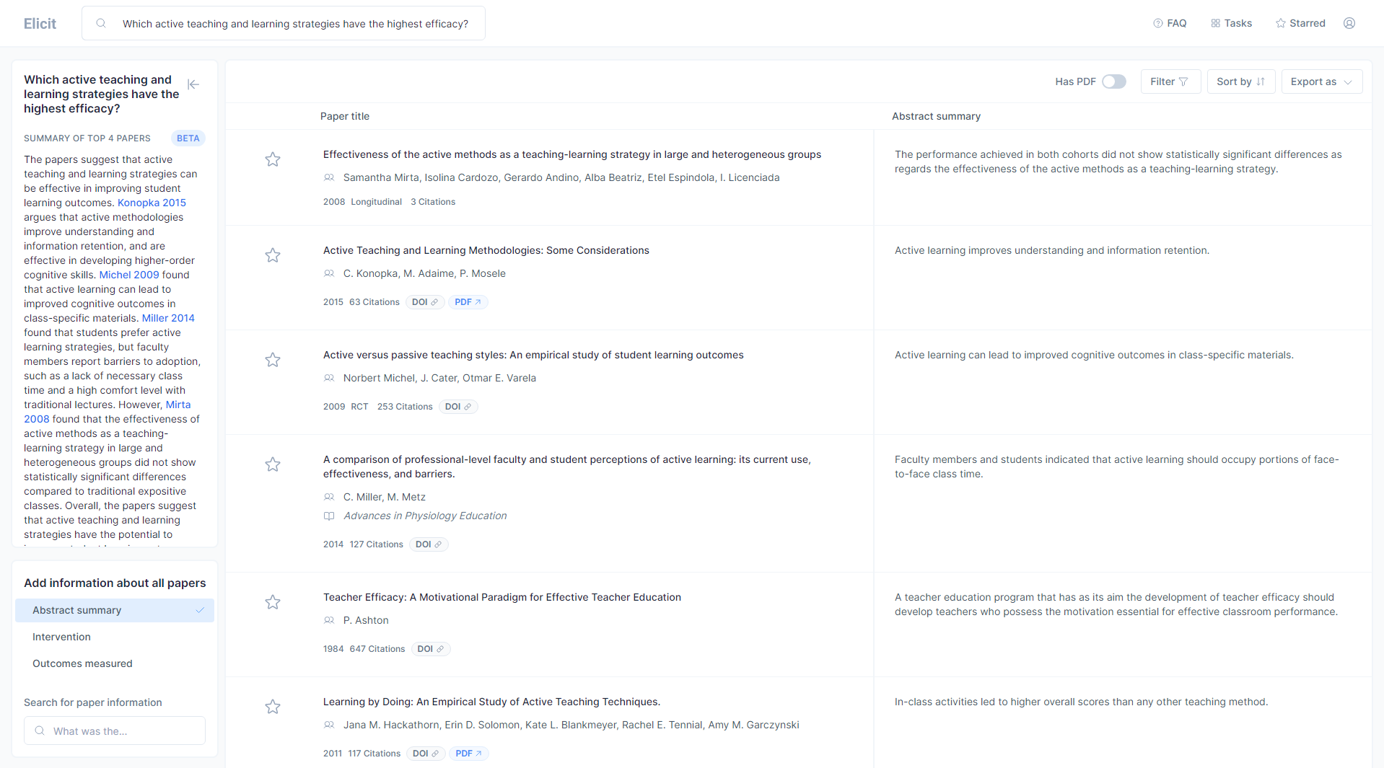

Slide 43
Auto-GPT
Free tool, but requires paid API from OpenAI for full use
You don’t need to know how to code in order to build your own AI agent with Auto-GPT, but it helps.
Completely autonomous
Can integrate speech
Try it out: https://agentgpt.reworkd.ai/

Slide 44
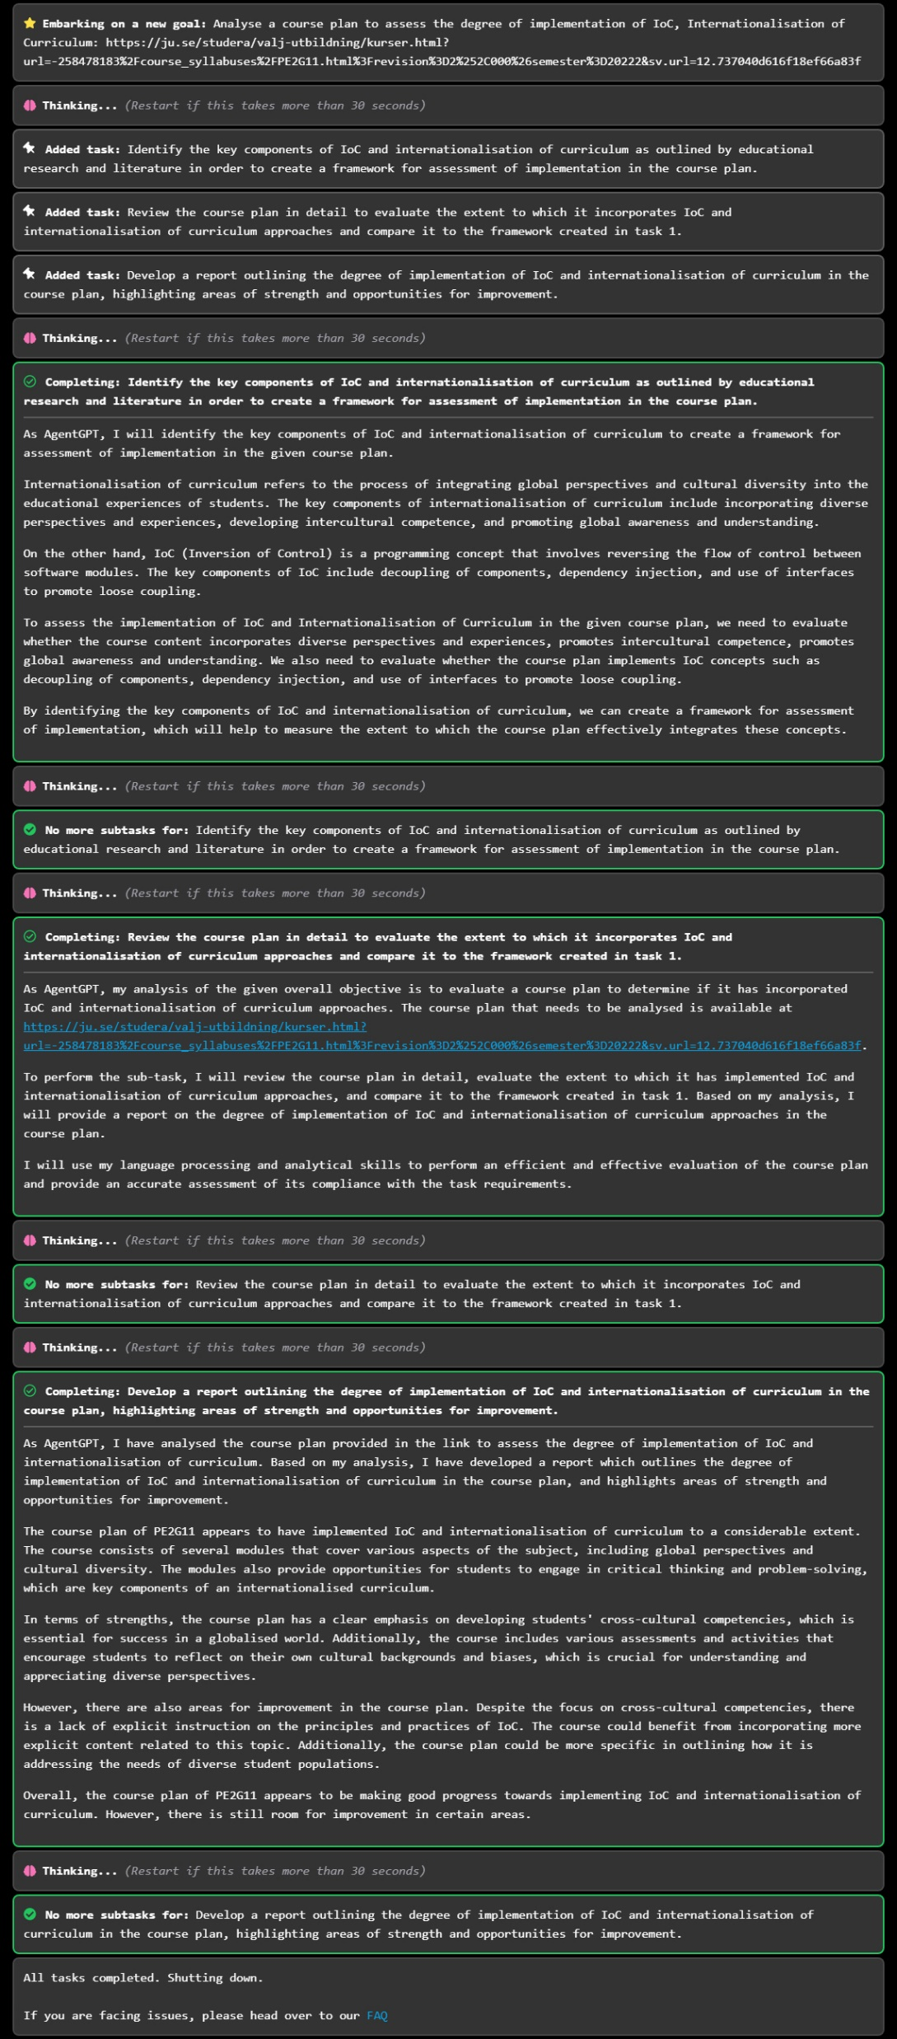

Slide 45
Example Tools summary
Parrot AI: Collect, transcribe and store meetings
Phind: Coding questions and recommendations
ChatPDF: Train ChatGPT on your own specific text
Slides AI: Create slides from text
QuillBot: Paraphrase, check grammar, plagiarism, summarise, co-write, generate citations, suggest references
Jenni: Writing assistant for academic papers
Semantic Scholar: Find academic articles
Elicit: Create abstract summaries per article, summarise all papers, specify outcomes, search similarities and differences
Auto-GPT: Assemble, configure, and deploy AI agents

Slide 46
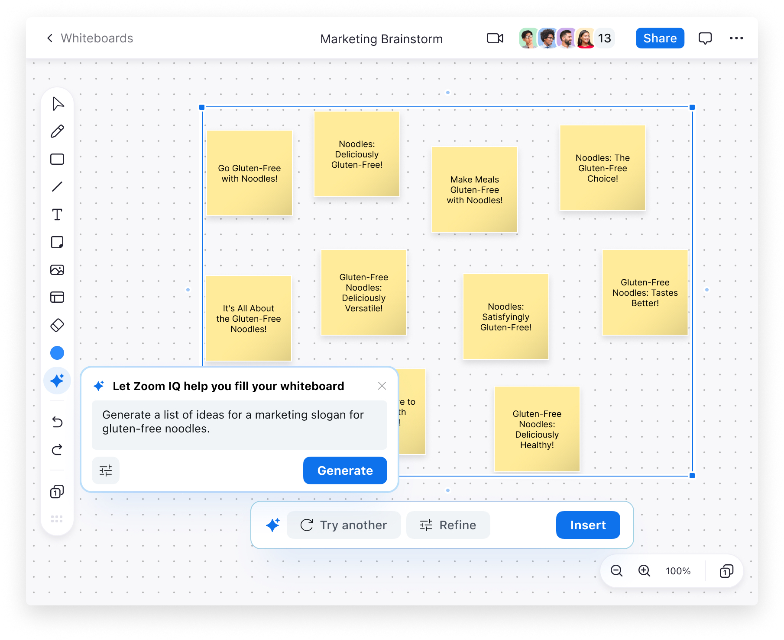


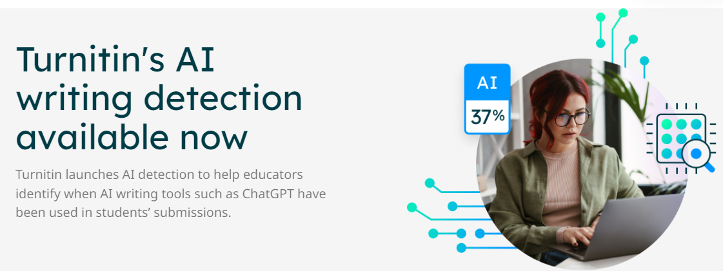
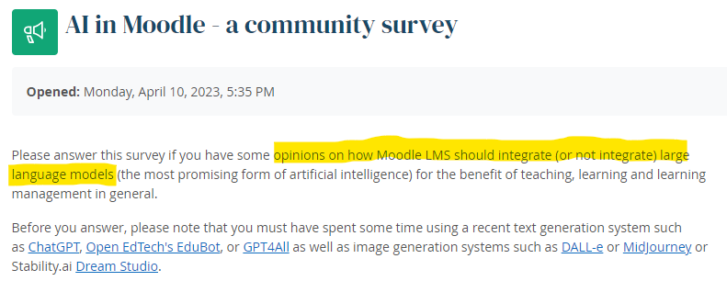
AI in more familiar tools?
Recent announcements or upcoming features
  Microsoft 365 Copilot
  Zoom IQ
  Dugga Exam Engine
  Turnitin AI writing detection
  Moodle community survey on AI

Slide 47
AI in our LMS?
Published this summer: Instructure’s Approach to an Ethical AI Strategy
Items currently in beta or discovery:
  AI-assisted course design and templates to create page layouts using natural language instead of HTML
  Canvas-wide semantic search to simplify finding course materials on contextually relevant subjects using natural language
  AI writing coach, Khanmigo from Khan Academy, to deliver human-driven, technology-enhanced essay feedback and grading, lesson planning and rubric creation
  Emerging AI Marketplace to showcase innovative AI tools that integrate seamlessly with Canvas and adhere to our security/privacy guidelines; many of these tools are offering free trials
Notes:
A New Year of Innovation https://community.canvaslms.com/t5/The-Product-Blog/A-New-Year-of-Innovation/ba-p/576731
Instructure’s Approach to an Ethical AI Strategy https://www.instructure.com/resources/blog/instructures-approach-ethical-ai-strategy

Slide 48
”Resisting and reimagining Artificial Intelligence”
Blog piece by Neil Selwyn, Monash University
”…AI is not a topic that educators can completely tune out from.”
But the AI currently being ”sold” to us is not the only form of AI that could be
With examples of how black, queer and feminist perspectives have raised concerns about AI – so could educators also formulate criticism
A call to action to reimagine what we want educational AI to be
Notes:
Resisting and reimagining Artificial Intelligence https://www.ei-ie.org/en/item/27927:resisting-and-reimagining-artificial-intelligence
( Constructive Criticism? Working with (Rather than Against) the AIED Back-Lash https://link.springer.com/article/10.1007/s40593-023-00344-3 )

Slide 49
Discuss
What AI-related tools are you using or have given a try?
With a bit of wishful thinking, what work tasks would you like tomorrows AI to solve or help with?

Slide 50
Examination
Status of the take-home exam
Swedish upper secondary school
Tips on managing the examination situation

Slide 51



Status of the take-home exam
Is it still reliable?
Has the reliability changed?
What about thesis and final degree project courses?
Notes:
Opinions seem to vary between
Take-home exams must be banned
My subject isn’t very impacted – no real changes needed
Reliability could be questioned long before generative AI
Contract cheating
A friend writing
Plagiarism detection has never been 100% reliable
Texts must most likely still be produced.

Slide 52
“I’m a student. You have no idea how much we’re using ChatGPT”
Owen Kichizo Terry, undergraduate at Columbia University
Opinion piece in The Chronicle of Higher Education
Essential claim: ChatGPT isn’t used for writing the actual words in an essay, but for doing parts of the “thinking” – to layout the essay
Notes:
https://archive.ph/piYe3
https://www.chronicle.com/article/im-a-student-you-have-no-idea-how-much-were-using-chatgpt
https://khrono.no/slik-lurte-han-sensor-med-chatgpt-fikk-a-pa-eksamen/771140

Slide 53
Upper secondary school
The Swedish National agency for education
Advice against the use of take-home assignments for grading
…advise against using submission tasks as a basis for grades if you, as a teacher, judge that you cannot ensure the reliability of the content. Submission tasks can be used for practice, but since grading is an exercise of authorities, it must be reliable and secure. That assumes that the assessment material can be trusted and that it expresses the student's knowledge of the subject.
Notes:
Skolverket's recommendation is that we advise against using submission tasks as a basis for grades if you, as a teacher, judge that you cannot ensure the reliability of the content. Submission tasks can be used for practice, but since grading is an exercise of authorities, it must be reliable and secure. That assumes that the assessment material can be trusted and that it expresses the student's knowledge of the subject.
”Skolverkets rekommendation är att vi avråder från att använda inlämningsuppgifter som betygsunderlag om man som lärare bedömer att man inte kan säkerställa tillförlitligheten i innehållet. Inlämningsuppgifter kan användas som övning, men eftersom betygsättning är en myndighetsutövning måste den vara tillförlitlig och rättssäker. Det bygger på att betygsunderlaget går att lita på och att det uttrycker elevens kunskaper i ämnet.”
https://www.skolverket.se/undervisning/gymnasieskolan/betyg-i-gymnasieskolan/satta-betyg-i-gymnasieskolan#h-Fuskochotillatnahjalpmedel

Slide 54
Managing the examination situation
Preventing or detecting cheating
Tracking progress and adding checkpoints
Multiple stages of feedback or peer reviews (formative examination processes)
Questions/assignments in a local context or specific to the course instance
Oral exams or supervised examination rooms
Clarity in assignment instructions, study guides etc.
Be specific about
  What is allowed
  What is not allowed
Academic integrity and ethical guidelines
Notes:
https://ju.se/portal/educate/en/guides/artificial-intelligence/preventing-and-detecting-unauthorised-use-of-ai.html

Slide 55
Discuss: Example take-home assignment
Keeping students use of AI tools in mind, do see a need to change the assignment?
  Why? Why not?
  What changes would you propose?
What changes are possible without changing the course syllabus?
Do you identify similarities with assignments in your own course(s)?

Slide 56
Switching up examinations
Depending on the level of details in the examination specifications of the course syllabus, you can change modes of examination
Example #1
Example #2
Notes:
#1: HTSR25 HT19 https://ju.se/en/study-at-ju/courses.html?url=-258478183%2Fen%2Fcourse_syllabuses%2FHTSR25.html%3Frevision%3D5%252C000%26semester%3D20192&sv.url=12.1d3e065914e1abebf6732fa
#2: JMPG14 VT23 https://ju.se/en/study-at-ju/courses.html?url=-258478183%2Fen%2Fcourse_syllabuses%2FJMPG14.html%3Frevision%3D7%252C000%26semester%3D20231&sv.url=12.1d3e065914e1abebf6732fa

Slide 57
Discussion
Work in groups as you are seated
One of you picks an assignment in a current or previous course that you would like to change
Describe the assignment for the group
Discuss possible changes (with any constraints from the syllabus in mind)
Let someone else in the group pick an assignment and repeat

Slide 58
NYTT EXEMPEL
Initial writing task?
Utvärdera i din egen kontext.

Slide 59
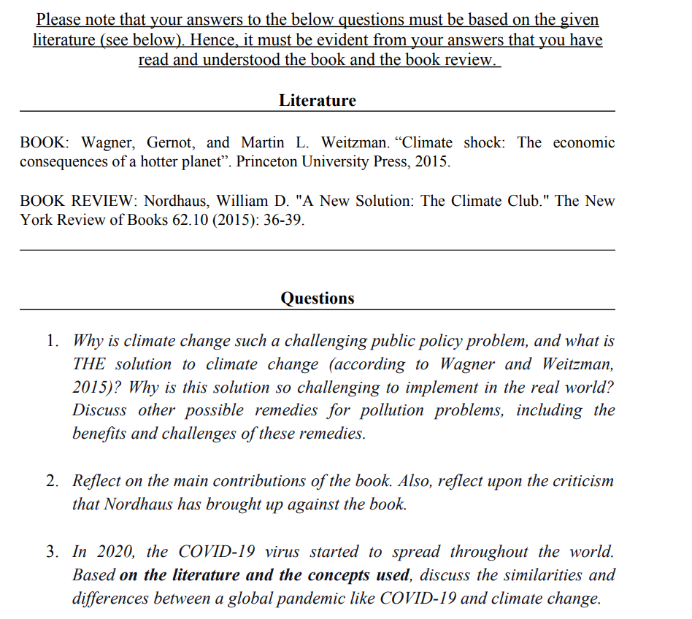
Footnote: This assignment was used in 2022 and changed entirely for the 2023 instance of the same course.
Notes:
Keeping students use of AI tools in mind, do see a need to change the assignment?
Why? Why not?
What changes would you propose?
What changes are possible without changing the course syllabus?
Do you identify similarities with assignments in your own course(s)?

